Slide 1
EE 1520 計算機概論二 （一一三學年下學期） Introduction to Computer Science (II) Slide Set 03
S. Felix Wu
sfelixwu@gs.ncku.edu.tw
https://github.com/sfelixwu/ee1520
https://www.youtube.com/@sfelixwu
https://discord.gg/PrJKQsKT

Slide 2
Review
Addressable Memory Boxes
OS and Virtual Memory Space/Layout
Installation of Ubuntu/WSL
Separate Compilation and Make (gcc, g++)

Slide 3
Today
JSON (Javascript Object Notation)
Object-Oriented Data Representation

Slide 4


04/15/2022

Slide 5

{
"product" :
{
"brand" : "Beck's",
"grp_id" : ”13504",
"name" : "Beck's Dark Beer - 12 Pk",
"upc14" : "00082488124003"
},
}

Slide 6

{
"from" :
{
"core" : { "owner_vsID" : "8177752121943525221986898990725294075” },
"store" : "Nugget Market”,
"vsID" : "56307055845342264413621510222129994875"
}
}

Slide 7

{
"discount" : 0.75,
"expiration" : "2020-06-36T18:34:24+0000",
"from" :
{
"core" : { "owner_vsID" : "8177752121943525221986898990725294075” },
"store" : "Nugget Market”,
"vsID" : "56307055845342264413621510222129994875"
},
"issued" : "2020-06-29T18:34:24+0000",
"message" : "beer 25% off",
"product" :
{
"brand" : "Beck's",
"grp_id" : ”13504",
"name" : "Beck's Dark Beer - 12 Pk",
"upc14" : "00082488124003"
},
"subject" : "coupon",
"to" :
{
"avatar_name" : ”Felix Wu",
"core" : { "owner_vsID" : "112638136365359060811666331781839957994” },
"vsID" : "19001943559317188636759421571670037357"
}
}

Slide 8
Objects
Description of Objects
The core issue of Object-Oriented programming!!
JSON (JavaScript Object Notation)
Representation of Objects
Standardized data interchange format

Slide 9
JSON
Linearization of an Object (C++, Python, Java)
How do we represent and store OBECTs without *** pointers ***?
{“key”:<value>}
{“key1”:Value1, “key2”: Value2,…}
“key” is a string, and we can re-order
{“latitude”: 38.53, “longitude”:-121.74}
{…, “home”: ????, ….}
{…, “home”: {“latitude”: 38.53, “longitude”:-121.74}, ….}

Slide 10
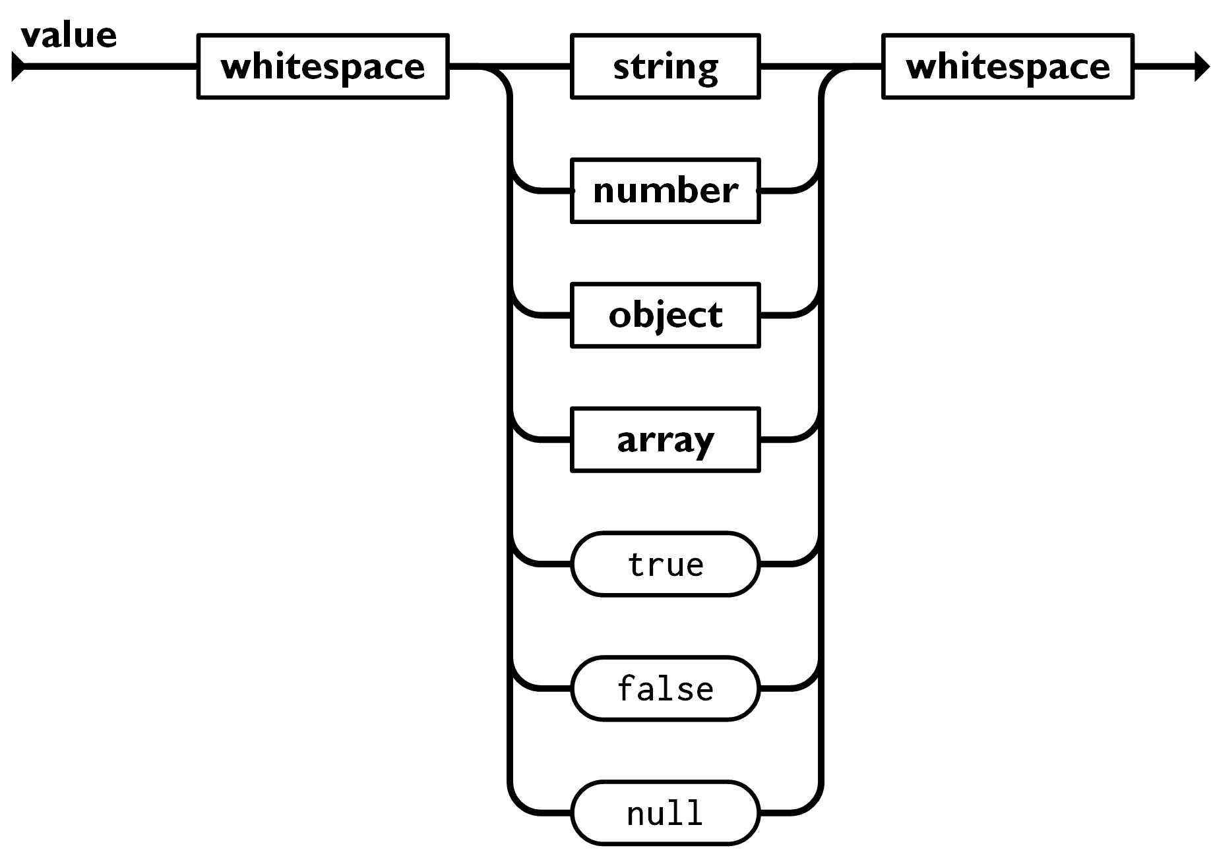
JSON Value Basic Types
Each Value could be basic data types such as string, bool, int, double, null, array, or Object
String “xyz”
Bool true, false
Int 22
Double 44.5123
Null null
Array [<value1>, <value2>, …]
Object {“key1”:<value1>, “key2”:<value2>…}

Slide 11
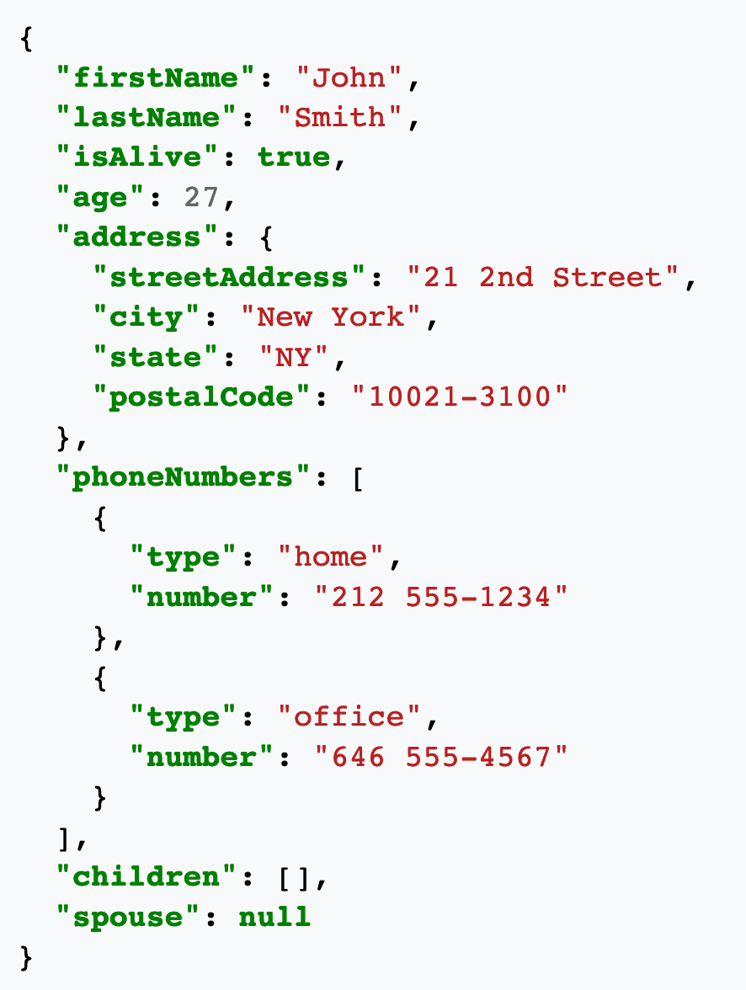
https://en.wikipedia.org/wiki/JSON

Slide 12
{
"discount" : 0.75,
"expiration" : "2020-06-36T18:34:24+0000",
"from" :
{
"core" : { "owner_vsID" : "8177752121943525221986898990725294075” },
"store" : "Nugget Market”,
"vsID" : "56307055845342264413621510222129994875"
},
"issued" : "2020-06-29T18:34:24+0000",
"message" : "beer 25% off",
"product" :
{
"brand" : "Beck's",
"grp_id" : ”13504",
"name" : "Beck's Dark Beer - 12 Pk",
"upc14" : "00082488124003"
},
"subject" : "coupon",
"to" :
{
"avatar_name" : ”Felix Wu",
"core" : { "owner_vsID" : "112638136365359060811666331781839957994” },
"vsID" : "19001943559317188636759421571670037357"
}
}

Slide 13
How many ways may I represent this picture?
04/15/2022

Slide 14
For Macbook user, you should follow this link to install JSONCPP -- https://formulae.brew.sh/formula/jsoncpp
For Ubuntu (or WSL Ubuntu), you will need to do the following –
sudo apt-get update
sudo apt-get upgrade
sudo apt-get install libjsoncpp-dev
sudo apt upgrade libjsoncpp-dev
For Ubuntu environments, you **might** also need to add -I/usr/include/jsoncpp in your Makefile to resolve “the <json/json.h> not found error”
Original Makefile CFLAGS = -g
Change to CFLAGS = -g -I/usr/include/jsoncpp

Slide 15
JSON
{“key”:[{…},{…},{…}…{…}]}
Facebook API
{“name_array”:{
{“data”:[{…},{…},{…}…{…}]},
{“count”: <size of array as int>}
}}

Slide 16
JSON ⬅ C array
{“key”:[{…},{…},{…}…{…}]}
Facebook API convention of JSON array ⬅ C++ vector
{“reactions”:{
{“data”:[{…},{…},{…}…{…}]},
{“count”: 1}
}}

Slide 17
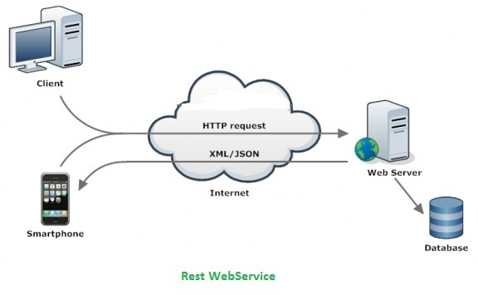
JSONs, together with XMLs, are flying on the Internet.
But, after passing the front end, only JSONs survived.
Representational State Transfer (REST)

Slide 18
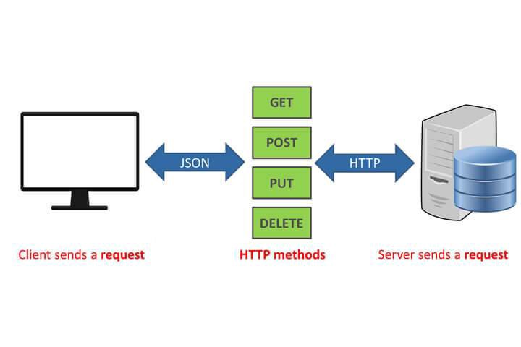

Slide 19
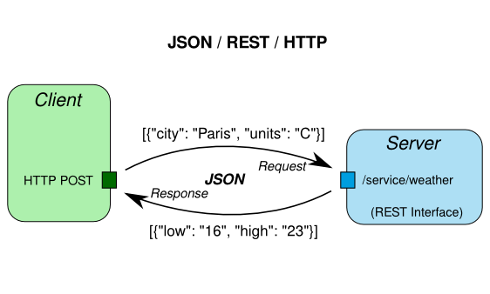

Slide 20


XML+JSON

Slide 21
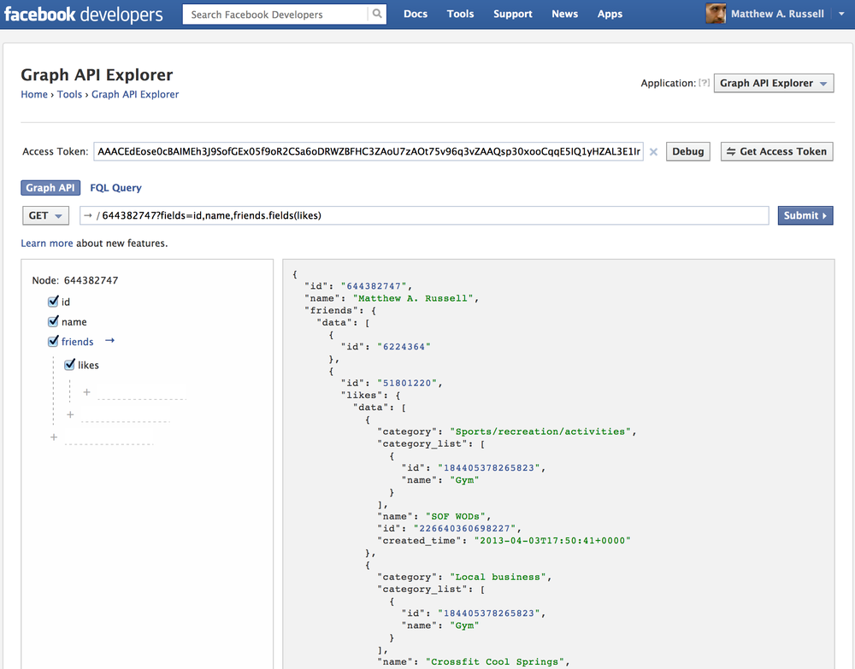

Slide 22
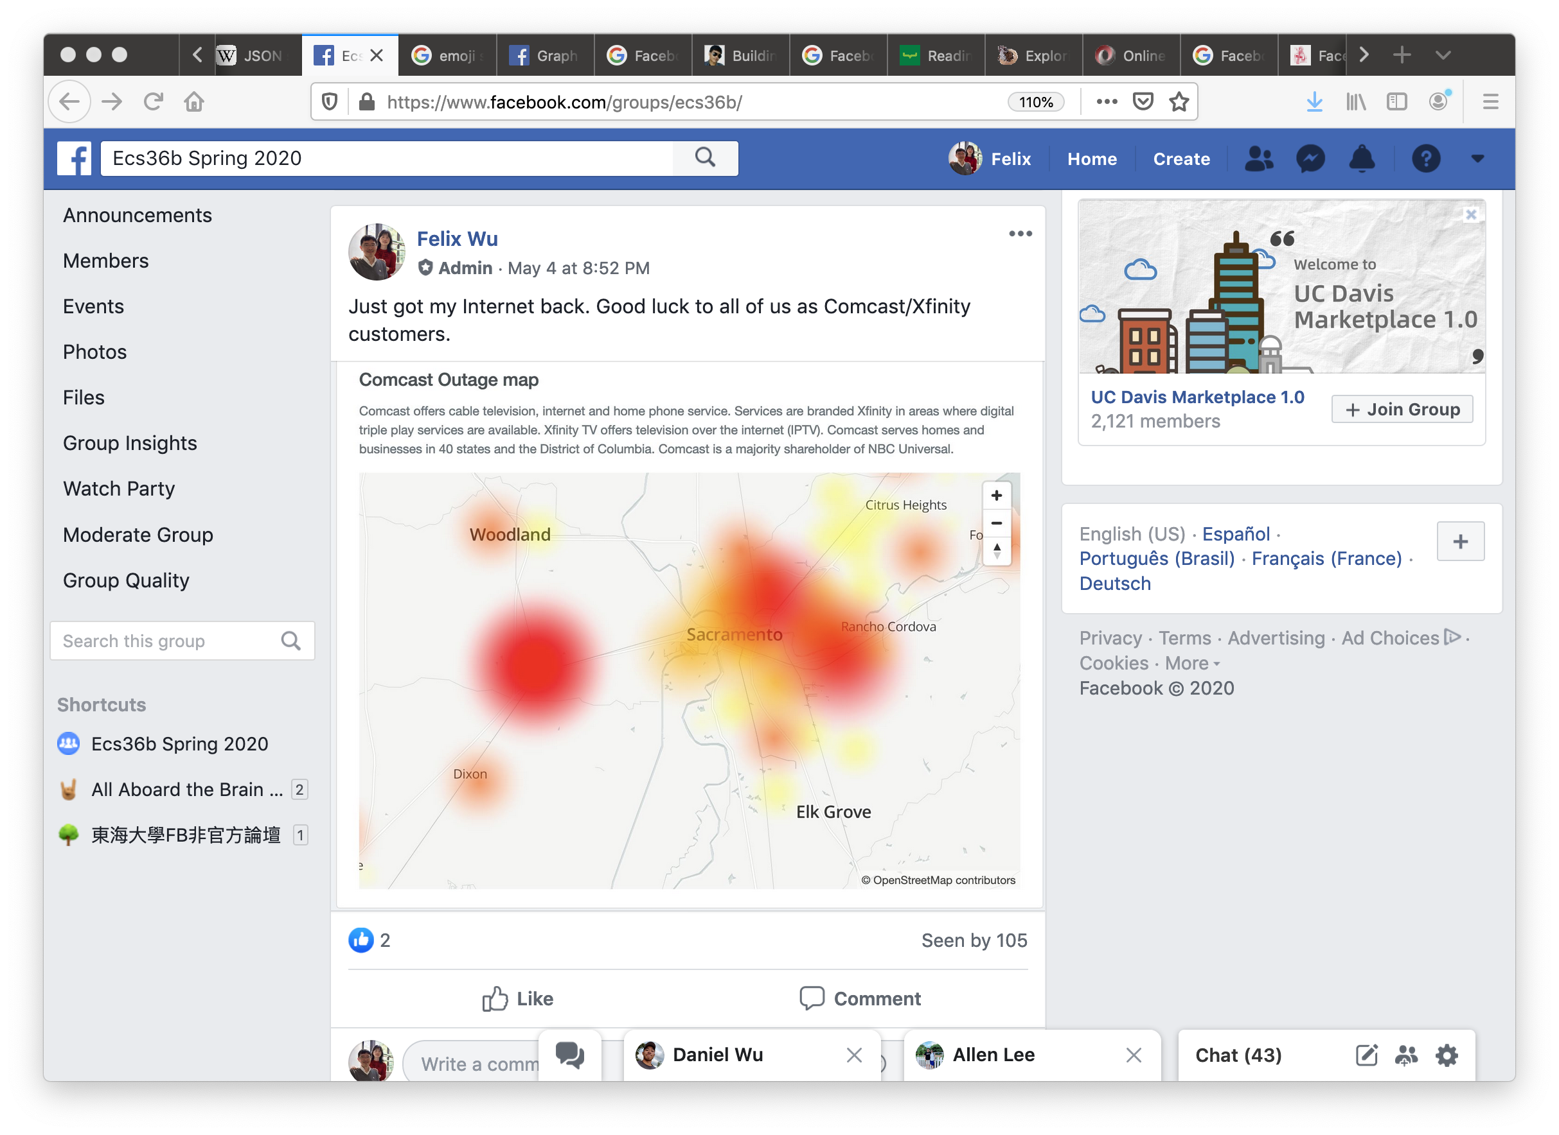

Slide 23





from Oracle (May 2, 2020, @ 4:37 pm) ➔
Just got my Internet back. Good luck to all of us as Comcast/Xfinity customers.
https://www.facebook.com/photo.php?fbid=10157251799685665
Post
Peter
from Peter (May 2, 2020, @ 4:41 pm) ➔
Professor Wu, can I get an extension even though I am an AT&T customer
Comment
Reactions
Peter
Oracle
from Oracle (May 2, 2020, @ 4:45 pm) ➔
AT&T customers got negative two days extension!
Comment
Peter
Oracle

Slide 24
{"id":"112638136365359060811666331781839957994_262650593813279","from":{"avatar_name":"Oracle","vsID":"112638136365359060811666331781839957994"},"to":{"data":[{"avatar_name":"Oracle","vsID":"112638136365359060811666331781839957994"}],"count":1},"message":"Just got my Internet back. Good luck to all of us as Comcast\/Xfinity customers.","links":{"data":[{"url":"https:\/\/www.facebook.com\/photo.php?fbid=10157251799685665","class_id":"photo","object_id":"281418948597993"}],"count":1},"actions":{"data":[{"name":"Comment","host_url":"http:\/\/localhost:8384","owner_vsID":"112638136365359060811666331781839957994","class_id":"Post","object_id":"262650593813279"},{"name":"Reaction","host_url":"http:\/\/localhost:8385","owner_vsID":"112638136365359060811666331781839957994","class_id":"Post","object_id":"262650593813279"}],"count":2},"created_time":"2020-05-02T16:37:27+0000","updated_time":"2020-05-02T16:45:18+0000","reactions":{"data":[{"avatar_name":"Peter","vsID":"1435196334234644184","type":"sad","created_time":"2020-05-02T16:37:27+0000"}],"count":1},"comments":{"data":[{"id":"112638136365359060811666331781839957994_262650593813279_262652393813099","from":{"avatar_name":"Peter","vsID":"1435196334234644184"},"message":"Professor Wu, can I get an extension even though I am an AT&T customer","created_time":"2020-05-02T16:41:17+0000","reactions":{"data":[{"avatar_name":"Peter","vsID":"1435196334234644184","type":"love","created_time":"2020-05-02T16:37:27+0000"},{"avatar_name":"Oracle","vsID":"112638136365359060811666331781839957994","type":"angry","created_time":"2020-05-02T16:39:14+0000"}],"count":2}},{"id":"112638136365359060811666331781839957994_262650593813279_262654177146254","from":{"avatar_name":"Oracle","vsID":"112638136365359060811666331781839957994"},"message":"AT&T customers got negative two days extension!","created_time":"2020-05-02T16:45:15+0000","reactions":{"data":[{"avatar_name":"Peter","vsID":"1435196334234644184","type":"sarcastic","created_time":"2020-05-02T16:45:27+0000"},{"avatar_name":"Oracle","vsID":"112638136365359060811666331781839957994","type":"happy","created_time":"2020-05-02T16:46:14+0000"}],"count":2}}],"count":2},"is_published":true}
base_input.json

Slide 25
{
"id":"112638136365359060811666331781839957994_262650593813279_262652393813099",
"from":{"avatar_name":"Peter","vsID":"1435196334234644184"},
"message":"Professor Wu, can I get an extension even though I am an AT&T customer",
"created_time":"2020-05-02T16:41:17+0000",
"reactions":{"data":[{"avatar_name":"Peter","vsID":"1435196334234644184","type":"love","created_time":"2020-05-02T16:37:27+0000"},{"avatar_name":"Oracle","vsID":"112638136365359060811666331781839957994","type":"angry","created_time":"2020-05-02T16:39:14+0000"}],"count":2}
}

Slide 26
{
"id":"112638136365359060811666331781839957994_262650593813279_262652393813099",
"from":{"avatar_name":"Peter","vsID":"1435196334234644184"},
"message":"Professor Wu, can I get an extension even though I am an AT&T customer",
"created_time":"2020-05-02T16:41:17+0000",
"reactions":{"data":[{“from”:{"avatar_name":"Peter","vsID":"1435196334234644184”},"type":"love","created_time":"2020-05-02T16:37:27+0000"},{"avatar_name":"Oracle","vsID":"112638136365359060811666331781839957994","type":"angry","created_time":"2020-05-02T16:39:14+0000"}],"count":2}
}

Slide 27
{
“from”:
{"avatar_name":"Peter","vsID":"1435196334234644184”},
"type":"love",
"created_time":"2020-05-02T16:37:27+0000”
}

Slide 28
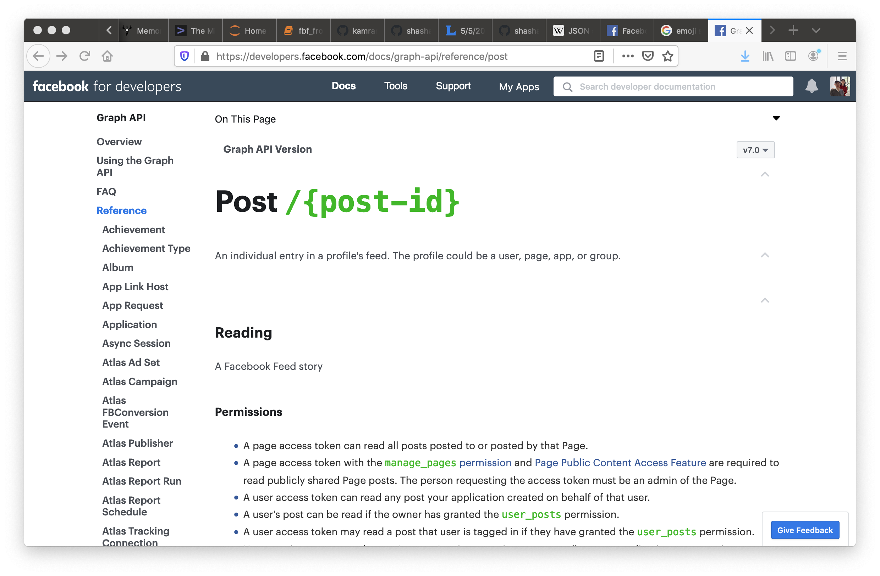
https://developers.facebook.com/docs/graph-api/reference/post

Slide 29
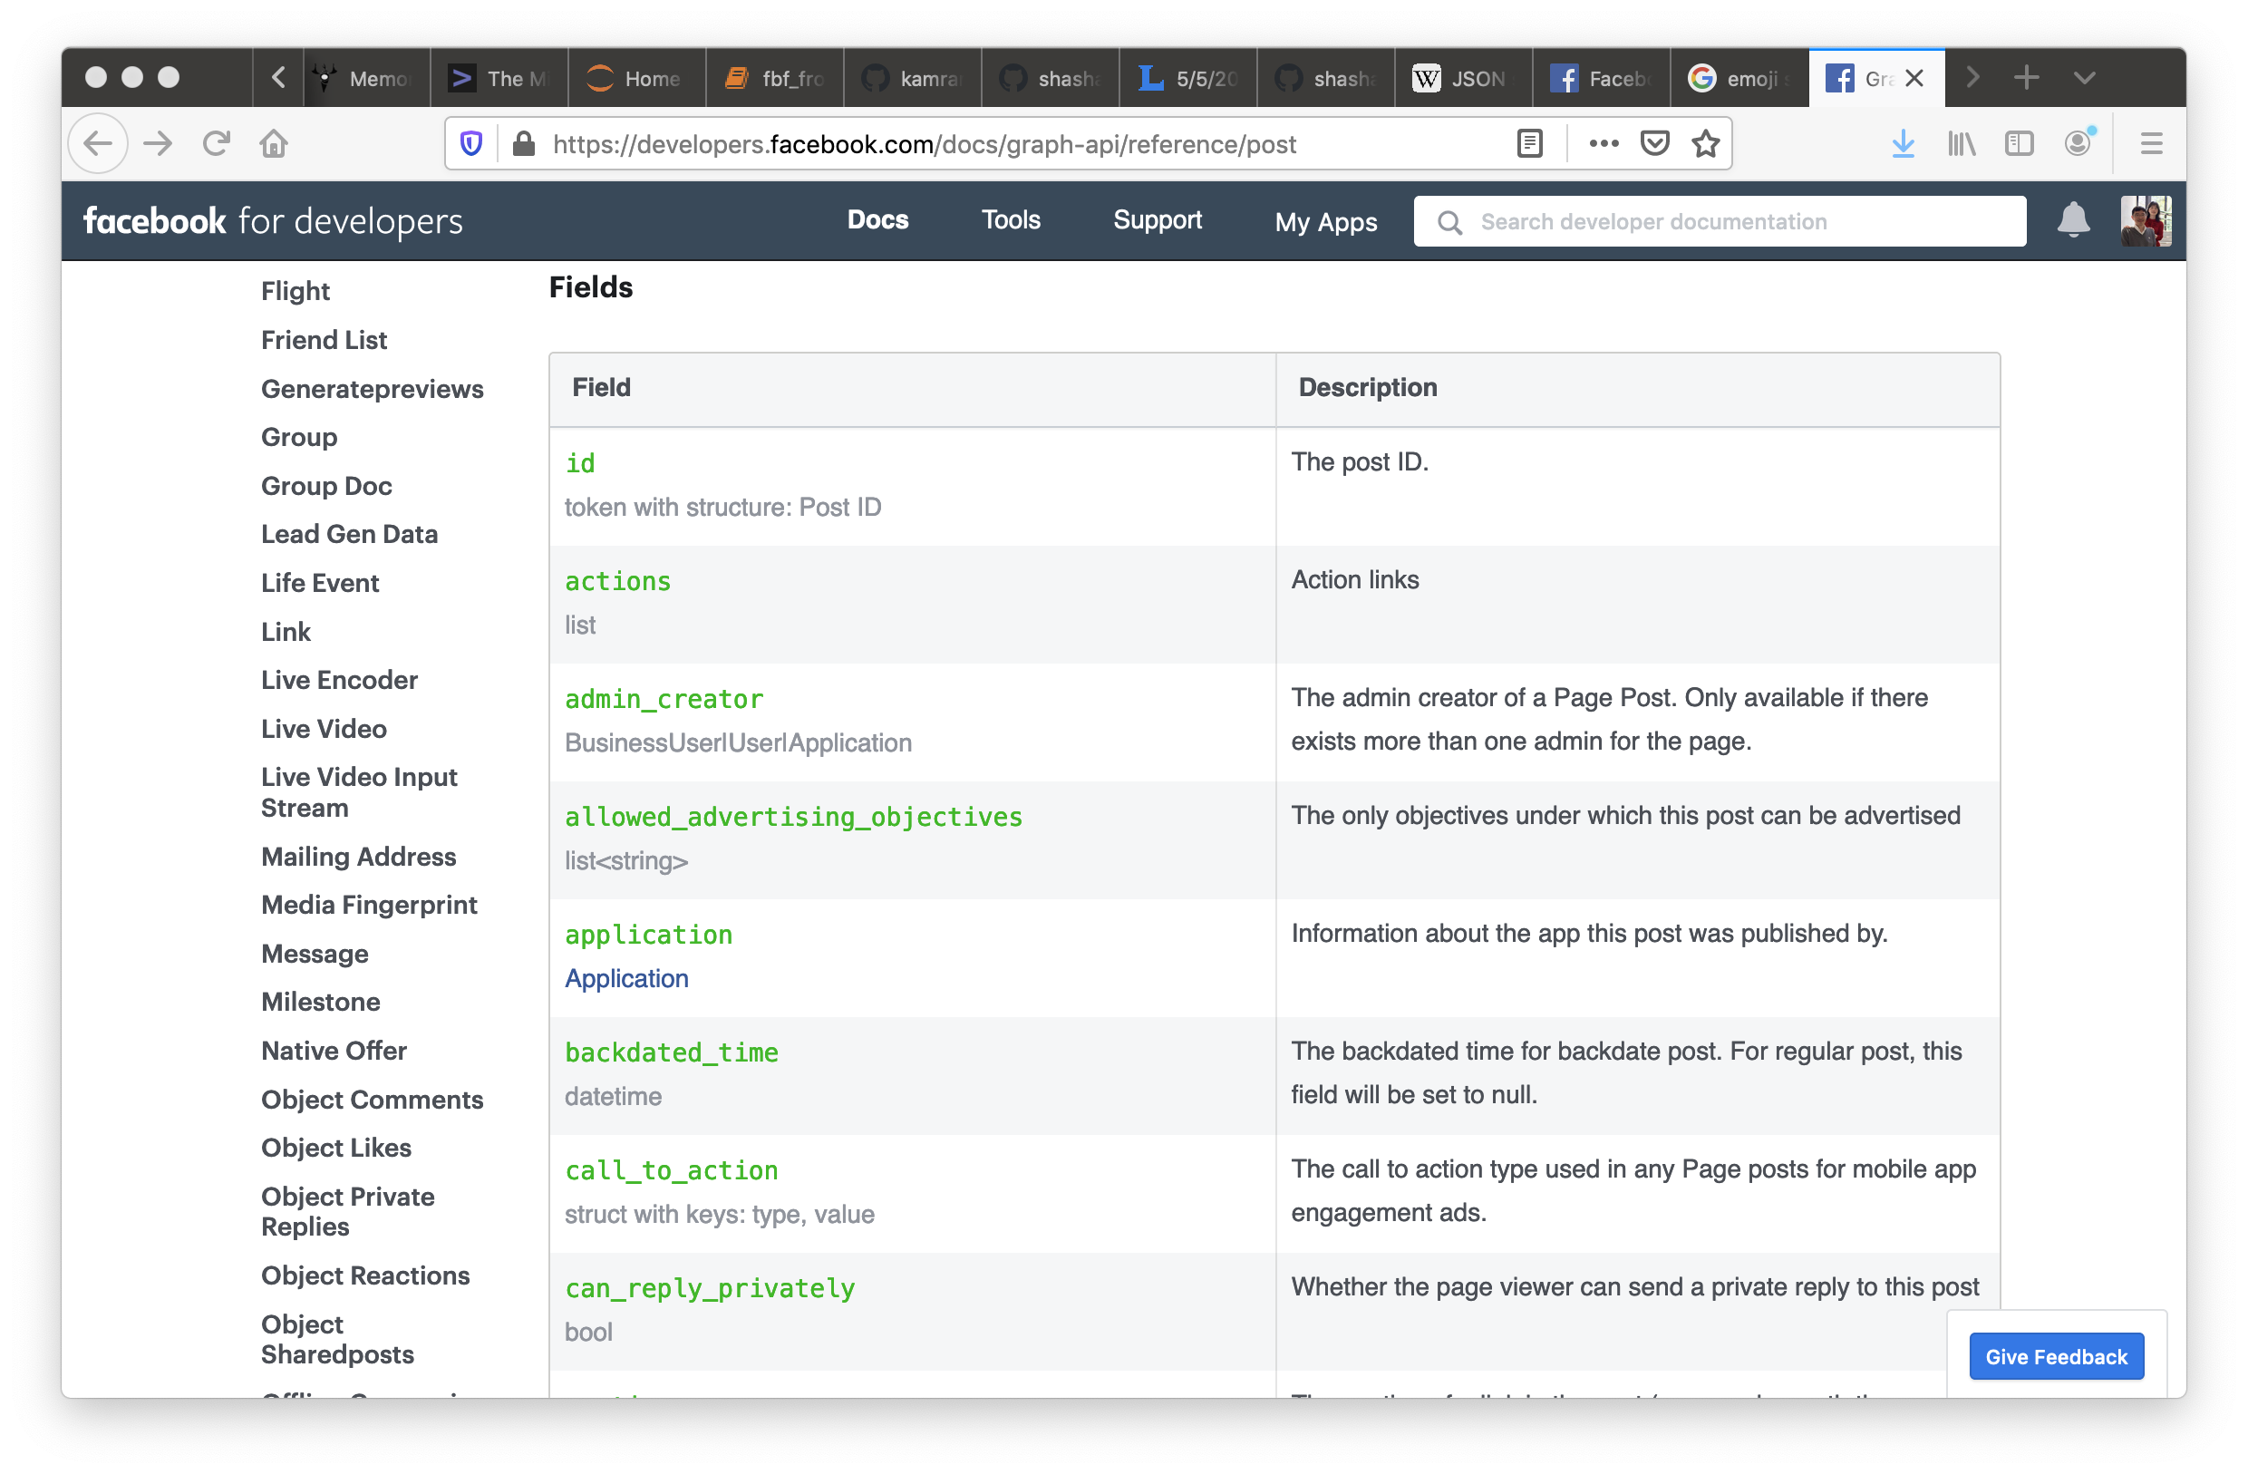

Slide 30
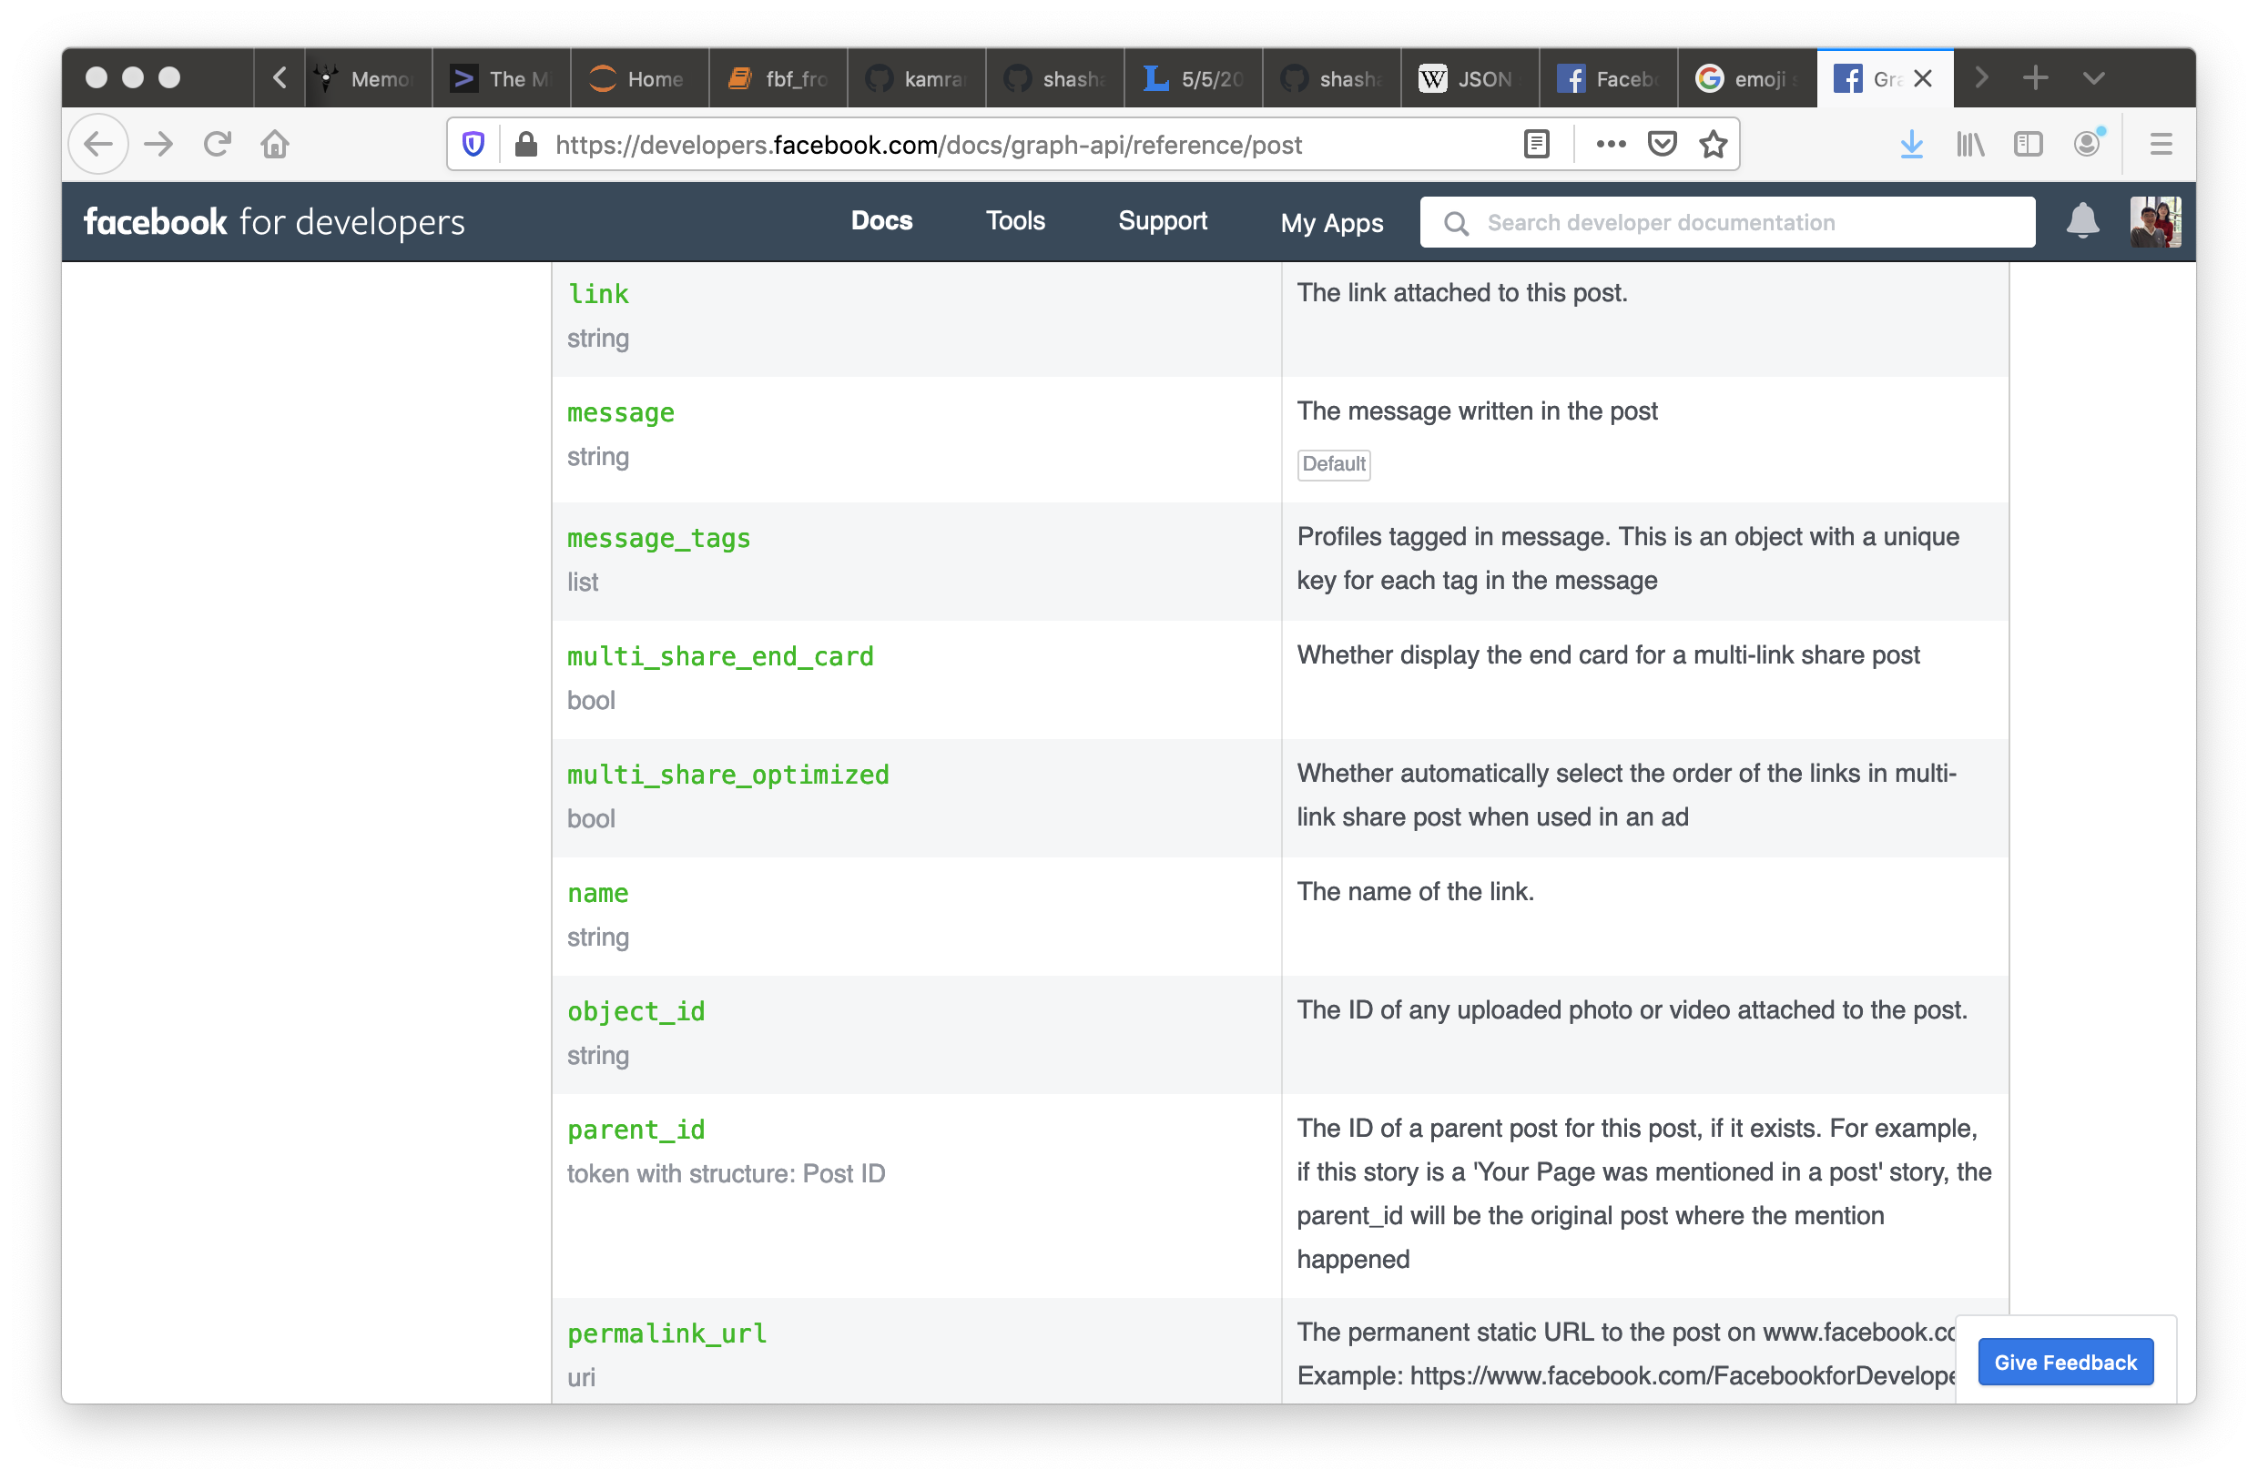

Slide 31
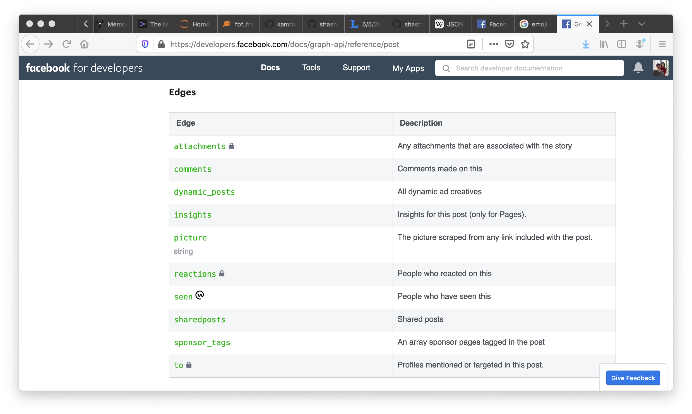

Slide 32
{
"id” : "112638136365359060811666331781839957994_262650593813279",
"from” : {
"avatar_name” : "Oracle",
"vsID” : "112638136365359060811666331781839957994”
},
"to” : {
"data” : [
{
"avatar_name” : "Oracle",
"vsID” : "112638136365359060811666331781839957994”
}
],
"count”. : 1
},
"message” : "Just got my Internet back. Good luck to all of us as Comcast/Xfinity customers.”,
"links” : {
"data” : [
{
"url” :
"https:\/\/www.facebook.com\/photo.php?fbid=10157251799685665",
"class_id” : "photo",
"object_id” : "281418948597993”
}
],
"count”. : 1
},

Slide 33
base_input.json
Core
Person
Post
JSON⬅➔C++
Message
Comment
Reaction

Slide 34
5 Steps for HW#5
Parse and Access JSON
Design and Implement C++ Classes for the base_input.json
Put parsed JSON fields, in layers, into pigeon-holes (of C++ objects)
Augment C++ Classes with dumpJ( )
Converting C++ value to Json::Value
Call dumpJ( ) to highest-level C++ object

Slide 35
We will support …
How to parse and access the JSON fields, layers, and arrays, with sample codes.
for (auto const& my_key : myv.getMemberNames()) {
std::cout << my_key << std::endl;
std::cout << myv[my_id] << std::endl;
}

Slide 36
Post
“id”:
“from”:
“created_time”:
“comments”: {
“reactions”: }
“reactions”:
…

Slide 37
Post
“id”:
“from”:
“created_time”:
“comments”: {
“reactions”: }
“reactions”:
…

Slide 38
// "reactions"
vector<Reaction *> vec_reactions;
if ((myv["reactions"]["count"]).asInt() > 0)
{
for (i = 0; i < (myv["reactions"]["count"]).asInt(); i++)
{
Json::Value l_jv = myv["reactions"]["data"][i];
Person *react_p_ptr =
new Person((l_jv["avatar_name"]).asString(),
(l_jv["vsID"]).asString());
MyTime *react_ctime_ptr = myGet_time_from_cstr
(((l_jv["created_time"]).asString()).c_str());
Reaction * react_ptr =
new Reaction(l_jv["type"].asString(),
react_p_ptr, react_ctime_ptr);
vec_reactions.push_back(react_ptr);
}
my_post.reactions = &vec_reactions;
}

Slide 39
// "reactions"
vector<Reaction *> vec_reactions;
if ((myv["reactions"]["count"]).asInt() > 0)
{
for (i = 0; i < (myv["reactions"]["count"]).asInt(); i++)
{
Json::Value l_jv = myv["reactions"]["data"][i];
Person *react_p_ptr =
new Person((l_jv["avatar_name"]).asString(),
(l_jv["vsID"]).asString());
MyTime *react_ctime_ptr = myGet_time_from_cstr
(((l_jv["created_time"]).asString()).c_str());
Reaction * react_ptr =
new Reaction(l_jv["type"].asString(),
react_p_ptr, react_ctime_ptr);
vec_reactions.push_back(react_ptr);
}
my_post.reactions = &vec_reactions;
}
http://jsoncpp.sourceforge.net/class_json_1_1_value.html

Slide 40
{"id":"112638136365359060811666331781839957994_262650593813279","from":{"avatar_name":"Oracle","vsID":"112638136365359060811666331781839957994"},"to":{"data":[{"avatar_name":"Oracle","vsID":"112638136365359060811666331781839957994"}],"count":1},"message":"Just got my Internet back. Good luck to all of us as Comcast\/Xfinity customers.","links":{"data":[{"url":"https:\/\/www.facebook.com\/photo.php?fbid=10157251799685665","class_id":"photo","object_id":"281418948597993"}],"count":1},"actions":{"data":[{"name":"Comment","host_url":"http:\/\/localhost:8384","owner_vsID":"112638136365359060811666331781839957994","class_id":"Post","object_id":"262650593813279"},{"name":"Reaction","host_url":"http:\/\/localhost:8385","owner_vsID":"112638136365359060811666331781839957994","class_id":"Post","object_id":"262650593813279"}],"count":2},"created_time":"2020-05-02T16:37:27+0000","updated_time":"2020-05-02T16:45:18+0000","reactions":{"data":[{"avatar_name":"Peter","vsID":"1435196334234644184","type":"sad","created_time":"2020-05-02T16:37:27+0000"}],"count":1},"comments":{"data":[{"id":"112638136365359060811666331781839957994_262650593813279_262652393813099","from":{"avatar_name":"Peter","vsID":"1435196334234644184"},"message":"Professor Wu, can I get an extension even though I am an AT&T customer","created_time":"2020-05-02T16:41:17+0000","reactions":{"data":[{"avatar_name":"Peter","vsID":"1435196334234644184","type":"love","created_time":"2020-05-02T16:37:27+0000"},{"avatar_name":"Oracle","vsID":"112638136365359060811666331781839957994","type":"angry","created_time":"2020-05-02T16:39:14+0000"}],"count":2}},{"id":"112638136365359060811666331781839957994_262650593813279_262654177146254","from":{"avatar_name":"Oracle","vsID":"112638136365359060811666331781839957994"},"message":"AT&T customers got negative two days extension!","created_time":"2020-05-02T16:45:15+0000","reactions":{"data":[{"avatar_name":"Peter","vsID":"1435196334234644184","type":"sarcastic","created_time":"2020-05-02T16:45:27+0000"},{"avatar_name":"Oracle","vsID":"112638136365359060811666331781839957994","type":"happy","created_time":"2020-05-02T16:46:14+0000"}],"count":2}}],"count":2},"is_published":true}
base_input.json

Slide 41
{"id":"112638136365359060811666331781839957994_262650593813279","from":{"avatar_name":"Oracle","vsID":"112638136365359060811666331781839957994"},"to":{"data":[{"avatar_name":"Oracle","vsID":"112638136365359060811666331781839957994"}],"count":1},"message":"Just got my Internet back. Good luck to all of us as Comcast\/Xfinity customers.","links":{"data":[{"url":"https:\/\/www.facebook.com\/photo.php?fbid=10157251799685665","class_id":"photo","object_id":"281418948597993"}],"count":1},"actions":{"data":[{"name":"Comment","host_url":"http:\/\/localhost:8384","owner_vsID":"112638136365359060811666331781839957994","class_id":"Post","object_id":"262650593813279"},{"name":"Reaction","host_url":"http:\/\/localhost:8385","owner_vsID":"112638136365359060811666331781839957994","class_id":"Post","object_id":"262650593813279"}],"count":2},"created_time":"2020-05-02T16:37:27+0000","updated_time":"2020-05-02T16:45:18+0000","reactions":{"data":[{"avatar_name":"Peter","vsID":"1435196334234644184","type":"sad","created_time":"2020-05-02T16:37:27+0000"}],"count":1},"comments":{"data":[{"id":"112638136365359060811666331781839957994_262650593813279_262652393813099","from":{"avatar_name":"Peter","vsID":"1435196334234644184"},"message":"Professor Wu, can I get an extension even though I am an AT&T customer","created_time":"2020-05-02T16:41:17+0000","reactions":{"data":[{"avatar_name":"Peter","vsID":"1435196334234644184","type":"love","created_time":"2020-05-02T16:37:27+0000"},{"avatar_name":"Oracle","vsID":"112638136365359060811666331781839957994","type":"angry","created_time":"2020-05-02T16:39:14+0000"}],"count":2}},{"id":"112638136365359060811666331781839957994_262650593813279_262654177146254","from":{"avatar_name":"Oracle","vsID":"112638136365359060811666331781839957994"},"message":"AT&T customers got negative two days extension!","created_time":"2020-05-02T16:45:15+0000","reactions":{"data":[{"avatar_name":"Peter","vsID":"1435196334234644184","type":"sarcastic","created_time":"2020-05-02T16:45:27+0000"},{"avatar_name":"Oracle","vsID":"112638136365359060811666331781839957994","type":"happy","created_time":"2020-05-02T16:46:14+0000"}],"count":2}}],"count":2},"is_published":true}
base_input.json

Slide 42
"reactions":{"data":[{"avatar_name":"Peter","vsID":"1435196334234644184",
"type":"sad","created_time":"2020-05-02T16:37:27+0000"}],"count":1}

Slide 43
"reactions":{"data":[{"avatar_name":"Peter","vsID":"1435196334234644184",
"type":"sad","created_time":"2020-05-02T16:37:27+0000"}],"count":1}
"reactions":{"data":[{"avatar_name":"Peter","vsID":"1435196334234644184",
"type":"sad","created_time":"2020-05-02T16:37:27+0000"}],"count":1}

Slide 44
"reactions":{"data":[{"avatar_name":"Peter","vsID":"1435196334234644184",
"type":"sad","created_time":"2020-05-02T16:37:27+0000"}],"count":1}
"reactions":{"data":[{"avatar_name":"Peter","vsID":"1435196334234644184",
"type":"sad","created_time":"2020-05-02T16:37:27+0000"}],"count":1}
"reactions":{"data":[{"avatar_name":"Peter","vsID":"1435196334234644184",
"type":"sad","created_time":"2020-05-02T16:37:27+0000"}],"count":1}

Slide 45
"reactions":{"data":[{"avatar_name":"Peter","vsID":"1435196334234644184",
"type":"sad","created_time":"2020-05-02T16:37:27+0000"}],"count":1}
"reactions":{"data":[{"avatar_name":"Peter","vsID":"1435196334234644184",
"type":"sad","created_time":"2020-05-02T16:37:27+0000"}],"count":1}
"reactions":{"data":[{"avatar_name":"Peter","vsID":"1435196334234644184",
"type":"sad","created_time":"2020-05-02T16:37:27+0000"}],"count":1}
if ((myv["reactions"]["count"]).asInt() > 0)
How do you tell whether the first reaction of the array was happy or sad?

Slide 46
if (((myv["reactions"]["count"]).asInt() > 0)) &&
(myv["reactions"][”data”]).isArray() == TRUE
(myv["reactions"][”data”][0]))
(myv["reactions"][”data”][0])).isObject() ==TRUE
(myv["reactions"][”data”][0][“type”]))
(myv["reactions"][”data”][0][“type”]).isString() == TRUE
(myv["reactions"][”data”][0][“type”]).asString() == “happy”
{
}

Slide 47
// "reactions"
vector<Reaction *> vec_reactions;
if ((myv["reactions"]["count"]).asInt() > 0)
{
for (i = 0; i < (myv["reactions"]["count"]).asInt(); i++)
{
Json::Value l_jv = myv["reactions"]["data"][i];
Person *react_p_ptr =
new Person((l_jv["avatar_name"]).asString(),
(l_jv["vsID"]).asString());
MyTime *react_ctime_ptr = myGet_time_from_cstr
(((l_jv["created_time"]).asString()).c_str());
Reaction * react_ptr =
new Reaction(l_jv["type"].asString(),
react_p_ptr, react_ctime_ptr);
vec_reactions.push_back(react_ptr);
}
my_post.reactions = &vec_reactions;
}

Slide 48
"reactions":{"data":[{"avatar_name":"Peter","vsID":"1435196334234644184",
"type":"sad","created_time":"2020-05-02T16:37:27+0000"}],"count":1}
"reactions":{"data":[{"avatar_name":"Peter","vsID":"1435196334234644184",
"type":"sad","created_time":"2020-05-02T16:37:27+0000"}],"count":1}
"reactions":{"data":[{"avatar_name":"Peter","vsID":"1435196334234644184",
"type":"sad","created_time":"2020-05-02T16:37:27+0000"}],"count":1}
"reactions":{"data":[{"avatar_name":"Peter","vsID":"1435196334234644184",
"type":"sad","created_time":"2020-05-02T16:37:27+0000"}],"count":1}
Json::Value l_jv = myv["reactions"]["data"][i];

Slide 49
Json::Value json_reactions;
Json::Value json_reactions_array;
"reactions":{"data":[{"avatar_name":"Peter","vsID":"1435196334234644184",
"type":"sad","created_time":"2020-05-02T16:37:27+0000"}],"count":1}
"reactions":{"data":[{"avatar_name":"Peter","vsID":"1435196334234644184",
"type":"sad","created_time":"2020-05-02T16:37:27+0000"}],"count":1}
Data ➔ array
Count ➔ size

Slide 50
"reactions":{"data":[{"avatar_name":"Peter","vsID":"1435196334234644184",
"type":"sad","created_time":"2020-05-02T16:37:27+0000"}],"count":1}
"reactions":{"data":[{"avatar_name":"Peter","vsID":"1435196334234644184",
"type":"sad","created_time":"2020-05-02T16:37:27+0000"}],"count":1}
"reactions":{"data":[{"avatar_name":"Peter","vsID":"1435196334234644184",
"type":"sad","created_time":"2020-05-02T16:37:27+0000"}],"count":1}
"reactions":{"data":[{"avatar_name":"Peter","vsID":"1435196334234644184",
"type":"sad","created_time":"2020-05-02T16:37:27+0000"}],"count":1}
Json::Value l_jv = myv["reactions"]["data"][0];
Json::Value l_jv = myv["reactions"]["data"][i];

Slide 51
// "reactions"
vector<Reaction *> vec_reactions;
if ((myv["reactions"]["count"]).asInt() > 0)
{
for (i = 0; i < (myv["reactions"]["count"]).asInt(); i++)
{
Json::Value l_jv = myv["reactions"]["data"][i];
Person *react_p_ptr =
new Person((l_jv["avatar_name"]).asString(),
(l_jv["vsID"]).asString());
MyTime *react_ctime_ptr = myGet_time_from_cstr
(((l_jv["created_time"]).asString()).c_str());
Reaction * react_ptr =
new Reaction(l_jv["type"].asString(),
react_p_ptr, react_ctime_ptr);
vec_reactions.push_back(react_ptr);
}
my_post.reactions = &vec_reactions;
}

Slide 52
(l_jv["avatar_name"]).asString()
(myv["reactions"]["data"][i]["avatar_name"]).asString()
(l_jv["avatar_name"]).asString()
(myv["reactions"]["data"][i]["avatar_name"]).asString()
Indent
Understand reference implementation
Understand JSON C++ programming
Seg-fault or any kind of problem ➔ first step is locate the bug

Slide 53
// "reactions"
vector<Reaction *> vec_reactions;
if ((myv["reactions"]["count"]).asInt() > 0)
{
for (i = 0; i < (myv["reactions"]["count"]).asInt(); i++)
{
Json::Value l_jv = myv["reactions"]["data"][i];
Person *react_p_ptr =
new Person((l_jv["avatar_name"]).asString(),
(l_jv["vsID"]).asString());
MyTime *react_ctime_ptr = myGet_time_from_cstr
(((l_jv["created_time"]).asString()).c_str());
Reaction * react_ptr =
new Reaction(l_jv["type"].asString(),
react_p_ptr, react_ctime_ptr);
vec_reactions.push_back(react_ptr);
}
my_post.reactions = &vec_reactions;
}

Slide 54
// "reactions"
vector<Reaction *> vec_reactions;
if ((myv["reactions"]["count"]).asInt() > 0)
{
for (i = 0; i < (myv["reactions"]["count"]).asInt(); i++)
{
Json::Value l_jv = myv["reactions"]["data"][i];
Person *react_p_ptr =
new Person((l_jv["avatar_name"]).asString(),
(l_jv["vsID"]).asString());
MyTime *react_ctime_ptr = myGet_time_from_cstr
(((l_jv["created_time"]).asString()).c_str());
Reaction * react_ptr =
new Reaction(l_jv["type"].asString(),
react_p_ptr, react_ctime_ptr);
vec_reactions.push_back(react_ptr);
}
my_post.reactions = &vec_reactions;
}

Slide 55
// "reactions"
vector<Reaction *> vec_reactions;
if ((myv["reactions"]["count"]).asInt() > 0)
{
for (i = 0; i < (myv["reactions"]["count"]).asInt(); i++)
{
Json::Value l_jv = myv["reactions"]["data"][i];
Person *react_p_ptr =
new Person((l_jv["avatar_name"]).asString(),
(l_jv["vsID"]).asString());
MyTime *react_ctime_ptr = myGet_time_from_cstr
(((l_jv["created_time"]).asString()).c_str());
Reaction * react_ptr =
new Reaction(l_jv["type"].asString(),
react_p_ptr, react_ctime_ptr);
vec_reactions.push_back(react_ptr);
}
my_post.reactions = &vec_reactions;
}

Slide 56
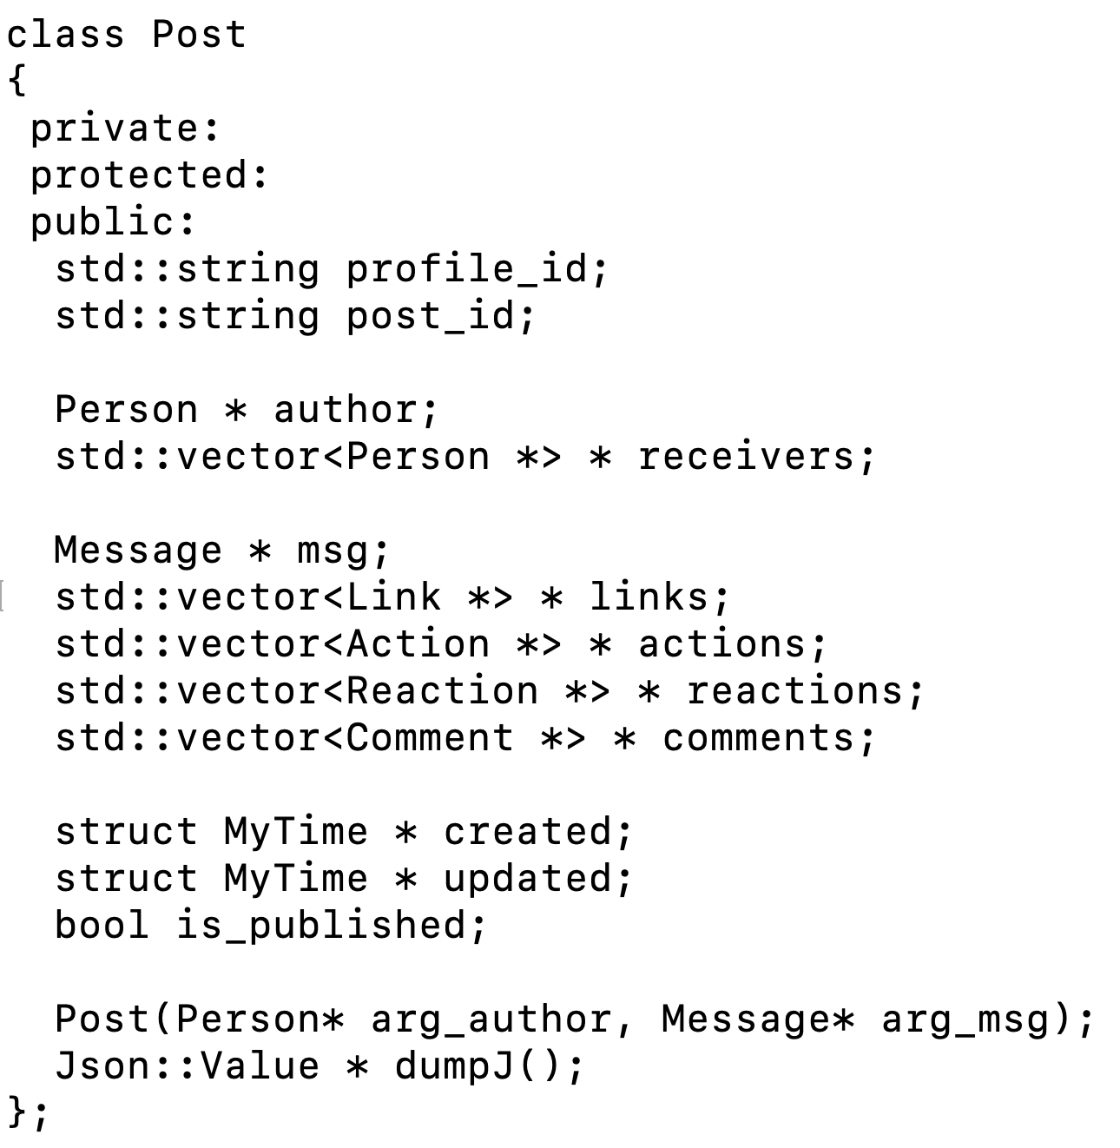

Slide 58
dumpJ()
Get the Json::Value representation from the C++ objects
Core
Persistent Objects
Transient Objects
Person
Post
base_input.json
JSON⬅➔C++
Message
Comment
Reaction

Slide 59
Json::Value * Reaction::dumpJ
(void)
{
Json::Value * result_ptr = (this->author)->dumpJ();
(*result_ptr)["type"] = this->type;
(*result_ptr)["created_time"] = *(myGet_time_dumpStr(this->created));
#ifdef _ECS36B_DEBUG_
std::cout << result_ptr->toStyledString() << std::endl;
#endif /* _ECS36B_DEBUG_ */
return result_ptr;
}

Slide 60
Json::Value * Reaction::dumpJ
(void)
{
Json::Value * result_ptr = (this->author)->dumpJ();
(*result_ptr)["type"] = this->type;
(*result_ptr)["created_time"] = *(myGet_time_dumpStr(this->created));
#ifdef _ECS36B_DEBUG_
std::cout << result_ptr->toStyledString() << std::endl;
#endif /* _ECS36B_DEBUG_ */
return result_ptr;
}

Slide 61
Json::Value * Person::dumpJ
(void)
{
Json::Value *result_ptr = new Json::Value();
(*result_ptr)["avatar_name"] = this->avatar_name;
(*result_ptr)["vsID"] = this->vsID;
#ifdef _ECS36B_DEBUG_
std::cout << result_ptr->toStyledString() << std::endl;
#endif /* _ECS36B_DEBUG_ */
return result_ptr;
}
Json::Value * Reaction::dumpJ
(void)
{
Json::Value * result_ptr = (this->author)->dumpJ();
(*result_ptr)["type"] = this->type;
(*result_ptr)["created_time"] = *(myGet_time_dumpStr(this->created));
#ifdef _ECS36B_DEBUG_
std::cout << result_ptr->toStyledString() << std::endl;
#endif /* _ECS36B_DEBUG_ */
return result_ptr;
}

Slide 62
Json::Value * Person::dumpJ
(void)
{
Json::Value *result_ptr = new Json::Value();
(*result_ptr)["avatar_name"] = this->avatar_name;
(*result_ptr)["vsID"] = this->vsID;
#ifdef _ECS36B_DEBUG_
std::cout << result_ptr->toStyledString() << std::endl;
#endif /* _ECS36B_DEBUG_ */
return result_ptr;
}
{"avatar_name":"Peter","vsID":"1435196334234644184"}
Json::Value * Reaction::dumpJ
(void)
{
Json::Value * result_ptr = (this->author)->dumpJ();
(*result_ptr)["type"] = this->type;
(*result_ptr)["created_time"] = *(myGet_time_dumpStr(this->created));
#ifdef _ECS36B_DEBUG_
std::cout << result_ptr->toStyledString() << std::endl;
#endif /* _ECS36B_DEBUG_ */
return result_ptr;
}
{"avatar_name":"Peter","vsID":"1435196334234644184","type":"sad","created_time":"2020-05-02T16:37:27+0000"}

Slide 63
5 Steps for HW#5
Parse and Access JSON
Design and Implement C++ Classes for the base_input.json
Put parsed JSON fields, in layers, into pigeon-holes (of C++ objects)
Augment C++ Classes with dumpJ( )
Converting C++ value to Json::Value
Call dumpJ( ) to highest-level C++ object

Slide 64
std::vector<Reaction *> * reactions;
reactions ➔ variable
reactions’s type ➔ pointer to a vector of pointers
comment_obj->reactions
R
R
Vector (1st)
0
1
2
3
pushback
R
R

Slide 65
std::vector<Reaction *> * reactions;
reactions ➔ variable
reactions’s type ➔ pointer to a vector of pointers
comment_obj->reactions
R
R
Vector (1st)
0
1
2
3
pushback
R
R
mypost
Pointer to a Vector <Action *>
(*(mypost_ptr->actions)).pushback(action_ptr);
actions

Slide 66
my_post.created = new JvTime(((myv_message["created_time"]).asString()).c_str());
Pointer to <Class_Type> = new
<Class_Type>(argument(s) to constructor for <Class_type>);
“Heap” malloc/free new/delete
<Class_Type> objX { … };
Scoping
Account *x_ptr;
for(;;)
{
Account x; // stack
x_ptr = &x;
}
*x_ptr

Slide 67
// "reactions” under comments
vector<Reaction *> * vec_reactions_ptr;
for (j = 0; j < (l_jv["reactions"]["count"]).asInt(); j++)
{
Json::Value l_jv_cr = l_jv["reactions"]["data"][i];
Person *react_p_ptr =
new Person((l_jv_cr["avatar_name"]).asString(),
(l_jv_cr["vsID"]).asString());
MyTime *react_ctime_ptr = myGet_time_from_cstr
(((l_jv["created_time"]).asString()).c_str());
Reaction * react_ptr =
new Reaction(l_jv["type"].asString(),
react_p_ptr, react_ctime_ptr);
vec_reactions_ptr->push_back(react_ptr);
}
comment_ptr->reactions = vec_reactions_ptr;

Slide 68
JSON Array
[“abc”, “cde”, “eee”]
[<person1>, <person2>, <person3>]
[<person1>, <phone>, <laptop>,<tax record>]

